Slide 1
English Lesson Starters
Title
Lesson Objective
Explanation
Exercise
Answers

Slide 2

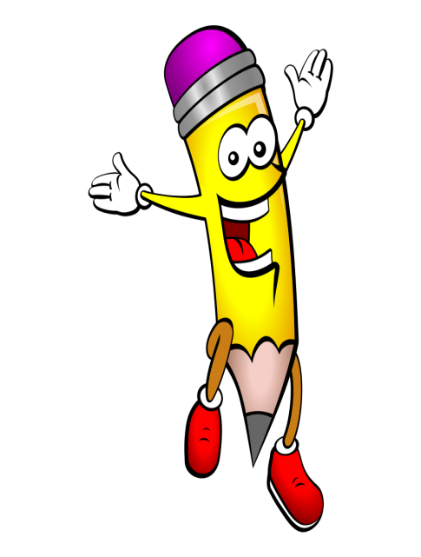
(1) Avoiding the Convenience Word: SAID
ANSWERS:
announced
bellowed
cried
demanded
exclaimed
finished
gabbled
hollered
insisted
joked
SAID is not a very descriptive word as it doesn’t tell us how something is actually spoken. There is no emotion in the word. If we take the first 10 letters of the alphabet, we can think of better alternatives. See if you can find them!
Learning Objective:
To improve your range of vocabulary for writing
‘The train is delayed,’ a___________ the conductor.
‘I’ve had enough,’ b_________ the man as loudly as possible.
‘Watch out! It’s going to hit you,’ c_____ out the girl.
‘I want compensation,’ d___________ the angry commuter.
The arrogant boy e__________ , ‘I’m a superstar!’
‘And so say all of us,’ f________ the crowd, after the speech.
‘Run for your life!’ g________ a confused, excitable woman.
The kid h___________ , ‘I’m not coming back to this dump!’
‘You must come back to visit,’ i_________ the hotel owner.
‘It’s the way I tell ‘em,’ j________ the comedian.
1. nanocuned
2. wlebloed
3. riced
4. medadned
5. micxelaed
6. sifnihed
7. balgbed
8. ellohred
9. tsisined
10. kjoed
Notes:
Answers: announced, bellowed, cried, demanded, exclaimed, finished, gabbled, hollered, insisted, joked

Slide 3

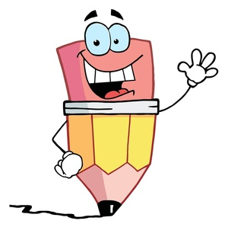
(8) Avoiding the Convenience Word: WENT
ANSWERS:
ambled
bolted
clambered
dragged
edged
followed
galloped
hobbled
inched
jogged
WENT is not a very descriptive word as it doesn’t describe anything about the way the subject is moving. Neither does it tell us anything about their mood. If we take the first 10 letters of the alphabet, we can think of better alternatives. See if you can find them!
Learning Objective:
To improve your range of vocabulary for writing
The care-free teenager slowly a______ down the road.
The eager sprinter b_______ past like lightning.
The exhausted ramblers c___________ up the steep hill.
The unwilling boy d______ his feet through the school gates.
The nervous first-time climber e______ herself over the cliff.
The directionless crowd f___________ the leader.
The keen children g_______ over the fields like frisky horses.
The injured athlete h_________ along to finish the race last.
The petrified woman i_______ along the side of the cliff.
The arrogant youth j______ past the geriatric group.
am
bo
cla
dr
ed
fo
ga
ho
in
jo
Notes:
Answers: ambled, bolted, clambered, dragged, edged, followed, galloped, hobbled, inched, jogged

Slide 4


(20) Suffixes – 4: -EOUS, -IOUS, -UOUS
ANSWERS:
-EOUS: spontaneous, gorgeous, hideous, courteous, righteous
-IOUS: suspicious, ambitious, precious, anxious, delicious
-UOUS: continuous, strenuous, ambiguous, virtuous, tempestuous
Now we have 3 suffix endings which sound the same and always cause problems. There is a difference with one of them. The –ious has only one sound (shus). The other two have 2 sounds: you-us (-uous) or ee-us (-eous).
Learning Objective:
To learn how to spell more accurately, those suffixes which sound similar
Here are 15 words for you to sort out into the correct suffix columns. Draw 3 columns with your 3 suffixes (as below), then place these beginnings in the correct columns. There should be 5 words of each:
spontan-, contin-, suspic-, stren-, ambit-, gorg-, ambig-,
hid-, prec-, anx-, court-, virt-, delic-, right-, tempest-
-EOUS | -IOUS | -UOUS
nauseous | spacious | conspicuous
Ps. The –ious suffix in ‘glorious’ does have 2 sounds: ee-us!!
Notes:
Answers: spontaneous, continuous, suspicious, strenuous, ambitious, gorgeous, ambiguous, hideous, precious, anxious, courteous, virtuous, delicious, righteous, tempestuous

Slide 5


(27) Extending Vocabulary - 5
ANSWERS:
copious – large amounts
dubious – unreliable
envious – jealous
delirious – wildly excited
devious – insincere, underhand
harmonious – sweet-sounding
hilarious – very funny
industrious – hard-working
luxurious – rich, expensive
notorious – well known for bad reason
Below are 10 more –IOUS adjectives. Again, all you have to do is match up the word and its definition. Use a dictionary to help you but you can probably guess some of them from hearing people use them:
Learning Objective:
To increase knowledge of new vocabulary and to practise using these new words in writing.
copious
dubious
envious
delirious
devious
harmonious
hilarious
industrious
luxurious
notorious
unreliable, dodgy
rich and expensive
insincere, underhand
well known for a bad reason
large amounts
wildly excited
jealous
very funny
sweet sounding
hard working
Extension Work: Now put these 10 words into 10 sentences of your own.
Notes:
Answers: copious – large amounts, dubious – unreliable, envious – jealous, delirious – wildly excited, devious – insincere, harmonious – sweet sounding, hilarious – very funny, industrious – hard working, luxurious – rich, expensive, notorious – well known for a bad reason

Slide 6


(58) Punctuation – 8: Using Commas in Direct Speech I
ANSWERS:
The foreman shouted, ‘Watch out for that cable!’
‘Mind the gap,’ repeated the announcer on the Tube platform.
The boy stuttered, ‘I...I...I... Think I’ve seen a ghost.’
‘The policeman called,’ warned the teenager’s father.
‘We want our money back,’ complained the customer.
The shop keeper remarked, ‘These are half-price.’
You probably know that speech marks are placed round the actual words spoken. However, commas are also used here, in two ways:
The girl said, ‘I’ve forgotten my homework.’
‘I’ve forgotten my homework,’ said the girl.
If you put the SAID-words first, you introduce the spoken words with a comma. If you begin with the speech, the comma comes inside the speech marks before the SAID-words are written.
Learning Objective:
To practise using commas before and after the SAID-word
Write out the following sentences, putting the commas in:
The foreman shouted ‘Watch out for that cable!’
‘Mind the gap’ repeated the announcer on the Tube platform.
The boy stuttered ‘I...I...I... Think I’ve seen a ghost.’
‘The policeman called’ warned the teenager’s father.
‘We want our money back’ complained the customer.
The shop keeper remarked ‘These are half-price.’

